Slide 1
SQL Server Query Execution and Plans
Module 7

Slide 2
Learning Units covered in this Module
Lesson 1: SQL Query Execution & Optimization
Lesson 2: SQL Query Plan Analysis
Notes:
The SQL Server Query Optimizer is a cost-based optimizer. Each possible execution plan has an associated cost in terms of the amount of computing resources used. The Query Optimizer must analyze the possible plans and choose the one with the lowest estimated cost. Some complex SELECT statements have thousands of possible execution plans. In these cases, the Query Optimizer does not analyze all possible combinations. Instead, it uses complex algorithms to find an execution plan that has a cost reasonably close to the minimum possible cost.
The SQL Server Query Optimizer does not choose only the execution plan with the lowest resource cost; it chooses the plan that returns results to the user with a reasonable cost in resources and that returns the results the fastest. For example, processing a query in parallel typically uses more resources than processing it serially, but completes the query faster. The SQL Server Query Optimizer will use a parallel execution plan to return results if the load on the server will not be adversely affected.
The SQL Server Query Optimizer relies on distribution statistics when it estimates the resource costs of different methods for extracting information from a table or index.
The SQL Server Query Optimizer is important because it enables the database server to adjust dynamically to changing conditions in the database without requiring input from a programmer or database administrator. This enables programmers to focus on describing the final result of the query. They can trust that the SQL Server Query Optimizer will build an efficient execution plan for the state of the database every time the statement is run.
Trivial plan optimization
If SQL Server knows that there is only one viable plan for a query, a lot of work can be avoided. For example, where there is only one possible plan:
A query that consists of an INSERT with a VALUES clause.
A SELECT statement for which all the columns are among the keys of a unique composite index, and that index is the only one that is relevant. No other index has that set of columns in it.
The trivial plan query optimizer finds the really obvious plans that are typically very inexpensive. This saves the query optimizer from having to consider every possible plan, which can be costly and can outweigh any benefit provided by well-optimized queries.
Simplification
If there is no trivial plan, SQL Server will perform a simplification. These are usually syntactic transformations of the query itself, to look for commutative properties and operations that can be rearranged. There is no cost or available index analysis. SQL Server then loads up the metadata, including the statistical information on the indexes.
Cost-based optimization
A set of transformation rules is followed that apply various permutations of data access strategies, join orders, aggregation placement, subquery transformations, and other rules that guarantee that a correct result is returned.
Optimization is broken up into three search phases to prevent the process from taking much longer than the execution of the query.
SQL Server evaluates the cost of the cheapest plan after each phase and executes that plan, if the plan is cheap enough. Otherwise, the query optimizer runs the next phase, which involves another set of usually more complex rules.
Phase 0 – Transactional Processing Phase: Contains a very limited set of rules and is applied only to simple queries with three or fewer tables. A limited number of join orders are evaluated, which may generate many potential plan candidates. Hash and nested loop join strategies are considered. If a plan with an estimated cost below 0.2 is found, the optimization ends and the query is executed. This phase is also known as the Transaction Processing phase, because query plans produced by this phase are typically found for queries in online transaction processing (OLTP) applications.
Phase 1 – Quick Plan Optimization Phase: More transformation rules and different join orders are evaluated. If the best plan costs less than 1.0, the optimization ends.
The query optimizer has considered only non-parallel execution plans so far. Phase 1 is repeated with the goal of finding the best parallel plan if:
More than one logical CPU is available to SQL Server.
The least expensive plan produced by Phase 1 costs more than the Cost Threshold for Parallelism.
The cost is >= 1.
Phase 2 – Full Optimization Phase: The cost of the serial and parallel plans are compared and Phase 2 is executed for the cheaper plan. Outer join reordering and automatic indexed view substitution for multi-table views are also considered.
An internal timeout can occur and the Query Optimizer stops the optimization process and returns the least expensive plan it has found so far. This timeout event is also shown on the properties of a graphical plan as Reason For Early Termination of Statement Optimization or on an XML plan as StatementOptmEarlyAbortReason.
We should be aware that if the full optimization phase produced a parallel plan for this query, it does not necessarily mean that the plan will be executed on multiple processors. If the machine is very busy, and cannot support running a single query on multiple CPUs, the plan

Slide 3
Lesson 1: SQL Query Execution & Optimization

Slide 4

Objectives
After completing this learning, you will be able to:
Explain Query Compilation and Optimization Process.
Explain Query Execution Process.
Explain Recompilation causes.

Slide 5
SQL Server Execution Plan
Main components
Compiled Plan (or Query Plan)
Compilation produces a query plan, which is a read-only data structure used by any number of users.
Execution Context
A data structure used to hold information specific to a query execution, such as parameter values.
Parameter A = ? Parameter B = ? User = ?
Parameter A = 12 Parameter B = ‘xy’ User = Jorge
Parameter A = 100 Parameter B = ‘ftr’ User = Nabil
Parameter A = 11 Parameter B = ‘sd’ User = Walter
Query Plan
Execution Context 1
Execution Context 2
Execution Context 3
Notes:
A query plan is the actual method that SQL Server uses to access data. While a Transact-SQL (T-SQL) statement indicates what the request is, the query plan indicates how to run the request.
Logical operators describe the relational algebraic operation used to process a statement. In other words, logical operators describe conceptually what operation needs to be performed.
Physical operators actually implement the operation defined by a logical operator using a concrete method or algorithm. For example, join is a logical operation, whereas nested loops join is a physical operator.
A Query Plan:
Is also known as an Execution Plan.
Is a re-entrant, read-only data structure used by any number of users.
Contains the data access strategy for the query.
Does not store any user context.
Is never stored more than twice in memory. There is one copy for all serial executions and possibly one copy for all parallel executions. The parallel copy covers all parallel executions, regardless of their degree of parallelism.
An Execution Context is derived from a query plan. Execution contexts:
Hold the values needed for a specific execution of a query plan.
Are cached and reused.
Are created for each user concurrently executing a batch and will hold data (such as parameter values) specific to their execution.
Are not re-entrant. At any point of time, an execution context can be executing only one batch submitted by a session, and while the execution is happening, the context is not given to any other session or user.

Slide 6
SQL Server Execution Plan Caching
Overview
Part of the memory pool used to store execution plans – also known as plan cache.
The plan cache has two stores for all compiled plans:
The Object Plans cache store (OBJCP)
used for plans related to persisted objects (stored procedures, functions, and triggers).
The SQL Plans cache store (SQLCP)
used for plans related to autoparameterized, dynamic, or prepared queries.
Notes:
For further information refer to:
https://docs.microsoft.com/en-us/sql/relational-databases/query-processing-architecture-guide

Slide 7
SQL Server compilation and execution
Concepts
Compilation
Process of creating a good enough query execution plan, as quickly as possible for a query batch.
Refer to both the compilation of non-DML constructs in SQL statements (control flow, DDL, etc.) and the process of Query Optimization.
Query Execution
Process of executing the plan that is created during query compilation and optimization.
Notes:
For further information refer to:
https://docs.microsoft.com/en-us/sql/relational-databases/query-processing-architecture-guide

Slide 8
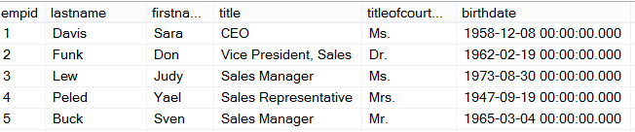
Ad Hoc Query
Stored Procedure
First Execution
or Recompile
Syntax
Parse
Execution Context
Resolve
(Binding)
Compile
Optimize
Execution Plan
Procedure Cache
Compile
Compile
Run Time
Execute
Execute
Execute
Execute
SQL
SQL
Sets
Sets
Notes:
For further information refer to:
https://docs.microsoft.com/en-us/sql/relational-databases/query-processing-architecture-guide
This post will describe how a SQL Server will PROCESS a query. The first time through running an Ad Hoc query or Stored Procedure, SQL Server will go through each of the following steps.
The first step is to Parse the statement into keywords, expressions, and operators. This is where the syntax of your query statement is checked for accuracy. Both the first and second steps are where you will find syntax errors. In most cases, these errors are caused by misspellings or putting commas in the wrong place.
The second step is to Resolve object names (Tables, Views, Columns, etc.) to see if they exist. This step also resolves aliases of columns and tables, as well as, resolves data types and performs implicit data type conversions. As a side note, if you read other blog posts, this step is technically called the Binding phase. I personally call this step the Resolving phase to help spell the word PROCESS as a memorization tool and also to fit the steps on a single slide during presentations.
The third step is to Optimize the query. This is where the query optimizer will find different ways of locating data from your tables based on available indexes and/or statistics. Once it figures a good enough plan to retrieve your result set using the least amount of resources, it will create an Execution Plan. Errors would only occur during this stage if there is a lack of hardware resources. Most compile errors happen at the next step.
The fourth step is to Compile the Execution Plan and store it in the Procedure Cache for future use.
Finally, the Execution Plan is passed to the Storage Engine to Execute the query and hopefully return the desired SQL Sets. This is where Run-Time errors will occur that need to be managed by using Exception Handling. (SQL Sets are normally called recordsets or rowsets, but I’m making a blog post on the PROCESS of queries not the PBOCERS of queries).
Additional submissions of the query from a Stored Procedure, will check the Procedure Cache for existing or similar Execution Plans that could be re-used for the query. If this is the case, the existing Execution Plan will be used to retrieve the SQL Sets using the Execution Context of the Stored Procedure.
It is possible for an Ad Hoc query to also re-use an existing plan from the procedure cache if the only thing that has changed in the query is the parameter value. Example: If a query had been written WHERE ProductID = 732 and was re-written WHERE ProductID = 738 the execution plan could be re-used, but if anything else changed, even by adding a space, the optimizer would compile a new execution plan.
One final thing. You will notice that you can have both an Estimated Execution Plan and an Actual Execution Plan. The difference is the first will show you what the plan would look like before the plan is compiled and the second will additionally add the values of actually running the plan that was placed in the procedure cache and executed.

Slide 9
What does the binding step resolve?
Resolve aliases of columns and tables
Data types and if implicit data type conversions are needed.
Object names (Tables, Views, Columns, etc.) to see if they exist.
User permissions are checked.
Does a cached plan exist?
Notes:
For further information refer to:
https://docs.microsoft.com/en-us/sql/relational-databases/query-processing-architecture-guide
This post will describe how a SQL Server will PROCESS a query. The first time through running an Ad Hoc query or Stored Procedure, SQL Server will go through each of the following steps.
The first step is to Parse the statement into keywords, expressions, and operators. This is where the syntax of your query statement is checked for accuracy. Both the first and second steps are where you will find syntax errors. In most cases, these errors are caused by misspellings or putting commas in the wrong place.
The second step is to Resolve object names (Tables, Views, Columns, etc.) to see if they exist. This step also resolves aliases of columns and tables, as well as, resolves data types and performs implicit data type conversions. As a side note, if you read other blog posts, this step is technically called the Binding phase. I personally call this step the Resolving phase to help spell the word PROCESS as a memorization tool and also to fit the steps on a single slide during presentations.
The third step is to Optimize the query. This is where the query optimizer will find different ways of locating data from your tables based on available indexes and/or statistics. Once it figures a good enough plan to retrieve your result set using the least amount of resources, it will create an Execution Plan. Errors would only occur during this stage if there is a lack of hardware resources. Most compile errors happen at the next step.
The fourth step is to Compile the Execution Plan and store it in the Procedure Cache for future use.
Finally, the Execution Plan is passed to the Storage Engine to Execute the query and hopefully return the desired SQL Sets. This is where Run-Time errors will occur that need to be managed by using Exception Handling. (SQL Sets are normally called recordsets or rowsets, but I’m making a blog post on the PROCESS of queries not the PBOCERS of queries).
Additional submissions of the query from a Stored Procedure, will check the Procedure Cache for existing or similar Execution Plans that could be re-used for the query. If this is the case, the existing Execution Plan will be used to retrieve the SQL Sets using the Execution Context of the Stored Procedure.
It is possible for an Ad Hoc query to also re-use an existing plan from the procedure cache if the only thing that has changed in the query is the parameter value. Example: If a query had been written WHERE ProductID = 732 and was re-written WHERE ProductID = 738 the execution plan could be re-used, but if anything else changed, even by adding a space, the optimizer would compile a new execution plan.
One final thing. You will notice that you can have both an Estimated Execution Plan and an Actual Execution Plan. The difference is the first will show you what the plan would look like before the plan is compiled and the second will additionally add the values of actually running the plan that was placed in the procedure cache and executed.

Slide 10

Yes
Trivial Plan?
Query Plan Created
Phase 2
Compare Plans and Full Optimization
No
Phase 1b
Quick Parallel Plans
Query Optimizer Phases
Yes
No
Simplification and Statistics
Yes
No
Cost < 1.0
or
MAXDOP = 1
Cost > Cost Threshold for Parallelism
Yes
Simple Query Tables <= 3
Cost < 0.2
Phase 0 Transactional Processing
No
Phase 1a
Quick Serial Plans
Notes:
The SQL Server Query Optimizer uses cost-based optimization to create an execution plan with the least cost, but that also consumes the least amount of resources. The Query Optimizer will not evaluate all possible combinations of plans but will create a “Good Enough” plan based on available information such as statistics and the data distribution.
Trivial Plan Optimization: The Query Optimizer goes through several phases in the process of query optimization. First it must determine if the query has a trivial plan. Specially, a query that has only one plan to consider, such as, a SELECT statement where all the columns can be found in a single table or index. If a trivial plan is found, this saves the query optimizer from having to evaluate multiple plans, which reduces the workload of the optimizer. If a trivial plan is discovered then the optimization ends, and the query plan is created.
Non-Trivial Plan Optimization: When a trivial plan is unable to be generated, the query optimizer performs a simplification process to try to discover if unnecessary joins can be removed, operations can be rearranged, or commutative properties folded (Instead of 5 + 6, use 11 as a value). Additionally, before moving on to the next step, statistics, data distribution, and index metadata are added to the query tree.
Cost-based optimization: Now the query optimizer will evaluate the query across three search phases to quickly identify the plan with the least cost.
Phase 0 – Transactional Processing Phase: When online transaction processing (OTLP) queries are evaluated and there are three tables or less, the optimizer evaluates a limited number of join operators (merge, hash match, or loop) for potential plan candidates. If the estimated cost is less than 0.2 then the optimization ends, and the query plan is created.
Phase 1a – Quick Serial Plan Optimization: Additional join orders and transformation rules are evaluated to create a cost-effective serial plan. If the plan cost is less than 1.0 then the optimization ends, and the query plan is created.
Phase 1b – Quick Parallel Plan Optimization: At this point, if the cost of the plan is greater than 1.0, MAXDOP is set to a value greater than 1, and the plan cost is greater than the Cost Threshold for Parallelism; then the query optimizer repeats Phase 1 until it finds the most efficient parallel plan.
Phase 2 – Compare Plans and Full Plan Optimization: At this point the serial plan that had a cost greater than 1.0 but less than the Cost Threshold for Parallelism is compared with the most efficient parallel plan. The optimizer will then take the cheaper of the two plans and consider if there are any additional ways of optimizing the ·execution plan. At this point, the optimization ends, and the query plan is created.
One final thing. You will notice that you can have both an Estimated Execution Plan and an Actual Execution Plan. The difference is the first will show you what the plan would look like before the plan is compiled and the second will additionally add the values of actually running the plan that was placed in the procedure cache and executed.

Slide 11
Query Simplification Process
Constant Folding: Expressions with constant values are reduced
Quantity = 2 + 3 becomes Quantity = 5
10 < 20 becomes True
Contradiction Detection: Removes criteria that doesn’t match table constraints
Constraint: Age > 18
Contradiction: WHERE Age < 18
Domain Simplification: Reduces complex ranges to simple ranges
Complex range: ID > 10 and ID < 20 or ID > 30 and < 50
Simplified range: ID > 10 and < 50
Join Simplification: Removes redundant joins that are not necessary
Predicate Pushdown: Perform calculations only on rows returned
Notes:
The SQL Server Query Optimizer uses cost-based optimization to create an execution plan with the least cost, but that also consumes the least amount of resources. The Query Optimizer will not evaluate all possible combinations of plans but will create a “Good Enough” plan based on available information such as statistics and the data distribution.
Trivial Plan Optimization: The Query Optimizer goes through several phases in the process of query optimization. First it must determine if the query has a trivial plan. Specially, a query that has only one plan to consider, such as, a SELECT statement where all the columns can be found in a single table or index. If a trivial plan is found, this saves the query optimizer from having to evaluate multiple plans, which reduces the workload of the optimizer. If a trivial plan is discovered then the optimization ends, and the query plan is created.
Non-Trivial Plan Optimization: When a trivial plan is unable to be generated, the query optimizer performs a simplification process to try to discover if unnecessary joins can be removed, operations can be rearranged, or commutative properties folded (Instead of 5 + 6, use 11 as a value). Additionally, before moving on to the next step, statistics, data distribution, and index metadata are added to the query tree.
Cost-based optimization: Now the query optimizer will evaluate the query across three search phases to quickly identify the plan with the least cost.
Phase 0 – Transactional Processing Phase: When online transaction processing (OTLP) queries are evaluated and there are three tables or less, the optimizer evaluates a limited number of join operators (merge, hash match, or loop) for potential plan candidates. If the estimated cost is less than 0.2 then the optimization ends, and the query plan is created.
Phase 1a – Quick Serial Plan Optimization: Additional join orders and transformation rules are evaluated to create a cost-effective serial plan. If the plan cost is less than 1.0 then the optimization ends, and the query plan is created.
Phase 1b – Quick Parallel Plan Optimization: At this point, if the cost of the plan is greater than 1.0, MAXDOP is set to a value greater than 1, and the plan cost is greater than the Cost Threshold for Parallelism; then the query optimizer repeats Phase 1 until it finds the most efficient parallel plan.
Phase 2 – Compare Plans and Full Plan Optimization: At this point the serial plan that had a cost greater than 1.0 but less than the Cost Threshold for Parallelism is compared with the most efficient parallel plan. The optimizer will then take the cheaper of the two plans and consider if there are any additional ways of optimizing the ·execution plan. At this point, the optimization ends, and the query plan is created.
One final thing. You will notice that you can have both an Estimated Execution Plan and an Actual Execution Plan. The difference is the first will show you what the plan would look like before the plan is compiled and the second will additionally add the values of actually running the plan that was placed in the procedure cache and executed.

Slide 12
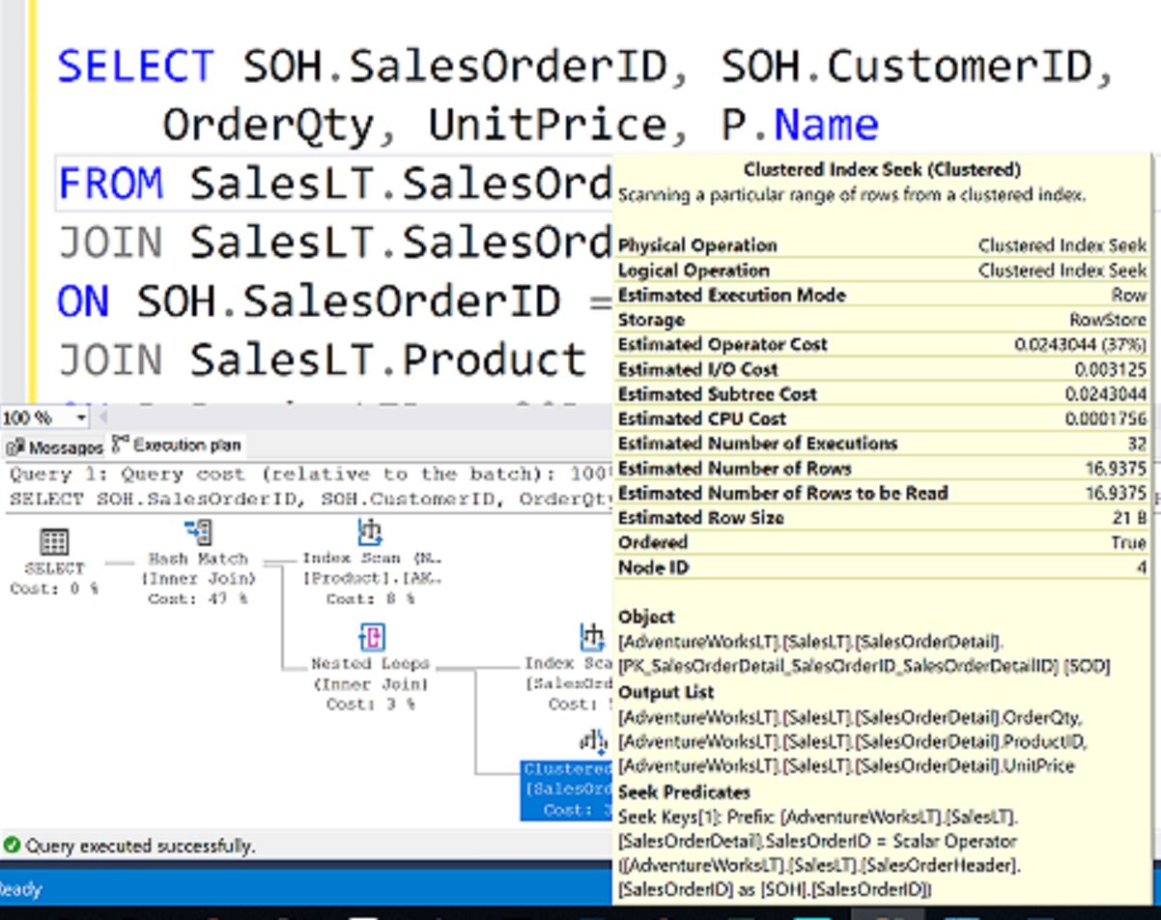
What is an Execution Plan?

Slide 13
How to see the query plan
Graphical execution plan
Estimated Execution Plan (Before Execution)
Live Query Statistics (During Execution)
Actual Execution Plan (After Execution)
The compiled plan.
The same as the compiled plan plus its execution context.
The same as the compiled plan plus its execution context.
This includes runtime information available after the execution completes, such as execution warnings, or in newer versions of the Database Engine, the elapsed and CPU time used during execution.
This includes runtime information during execution progress and is updated every second. Runtime information includes for example the actual number of rows flowing through the operators.
Enables rapid identification of potential bottlenecks.

Slide 14
SQL Server Execution Plan Recompilations
Overview
Most recompilations are required either for statement correctness or to obtain potentially faster query execution plan.
The engine detects changes that invalidate execution plan(s) and marks those as not valid. New plan must be recompiled for the next query execution.
Starting with SQL Server 2005, whenever a statement within a batch causes recompilation, only the statement inside the batch that triggers recompilation is recompiled.
Notes:
For further information refer to
https://docs.microsoft.com/en-us/sql/relational-databases/query-processing-architecture-guide
Plan Caching and Recompilation in SQL Server 2012 - https://docs.microsoft.com/en-us/previous-versions/sql/sql-server-2012/dn148262(v=msdn.10)

Slide 15
SQL Server Execution Plan Recompilations
Recompilation reasons
Table / Index Changes
Changes made to objects referenced by the query (ALTER TABLE and ALTER VIEW).
Changing or dropping any indexes used by the execution plan.
Stored Procedures
Changes made to a single procedure, which would drop all plans for that procedure from the cache (ALTER PROCEDURE).
Explicit call to sp_recompile.
Executing a stored procedure using the WITH RECOMPILE option.
Data Volume
Updates on statistics used by the execution plan
For tables with triggers, if the number of rows in the inserted or deleted tables grows significantly.
Other
Large numbers of changes to keys (generated by statements from other users that modify a table referenced by the query).
Temporary table changes

Slide 16

Questions?

Slide 17
Knowledge Check
What is meant by SQL Server’s query optimizer being cost-based?
When is a query considered for a parallel execution plan?
Will SQL Server evaluate every possible query plan in the process of optimization? Why?
Name two recompilation causes.
Notes:
Q: What is meant by SQL Server’s query optimizer being cost-based?
A: Cost-based means that SQL Server tries to optimize queries based on the estimated resources that it will take to run the query.
Q: When is a query considered for a parallel execution plan?
SQL Server will consider a parallel execution plan if more than one logical CPU is available to SQL Server. The least expensive plan produced by Phase 1 costs more than the Cost Threshold for Parallelism.
Q: Will SQL Server evaluate every possible query plan in the process of optimization? Why?
A: No, SQL Server will not consider every possible plan, because in many cases, this could prove to cost more than running the query with a non-optimal plan. SQL Server will choose a plan that is good enough.
Q:Name two recompilation causes.
A: Several possible options
Changes made to a table or view referenced by the query (ALTER TABLE and ALTER VIEW).
Changes made to a single procedure, which would drop all plans for that procedure from the cache (ALTER PROCEDURE).
Changes to any indexes used by the execution plan.
Updates on statistics used by the execution plan (explicitly or generated automatically).
Dropping an index used by the execution plan.
An explicit call to sp_recompile.
Large numbers of changes to keys (generated by statements from other users that modify a table referenced by the query).
For tables with triggers, if the number of rows in the inserted or deleted tables grows significantly.
Executing a stored procedure using the WITH RECOMPILE option.
Temporary table changed.

Slide 18
Lesson 2: SQL Server Query Plan Analysis

Slide 19
Objectives
After completing this learning, you will be able to:
Read execution plans.
Understand logical and physical join operators.
Describe data access.

Slide 20
How to see the query plan
Graphical execution plan
Estimated Execution Plan (Before Execution)
Live Query Statistics (During Execution)
Actual Execution Plan (After Execution)
The compiled plan.
The same as the compiled plan plus its execution context.
The same as the compiled plan plus its execution context.
This includes runtime information available after the execution completes, such as execution warnings, or in newer versions of the Database Engine, the elapsed and CPU time used during execution.
This includes runtime information during execution progress and is updated every second. Runtime information includes for example the actual number of rows flowing through the operators.
Enables rapid identification of potential bottlenecks.

Slide 21
Contents of an Execution Plan
Methods used to extract data from each table.
How data is joined
Use of temporary worktables and sorts
Estimated rowcount, iterations, and costs from each operator
Actual rowcount and iterations
Sequence in which the source tables are accessed.

Slide 22
How to see the query plan
Text and XML
 | Command | Execute query? | Include estimated row counts & stats (Estimated Query Plan) | Include actual row counts & stats (Actual Query Plan)
Text Plan | SET SHOWPLAN_TEXT ON | No | No | No
 | SET SHOWPLAN_ALL ON | No | Yes | No
 | SET STATISTICS PROFILE ON | Yes | Yes | Yes
XML Plan | SET SHOWPLAN_XML ON | No | Yes | No
 | SET STATISTICS PROFILE XML | Yes | Yes | Yes

Slide 23
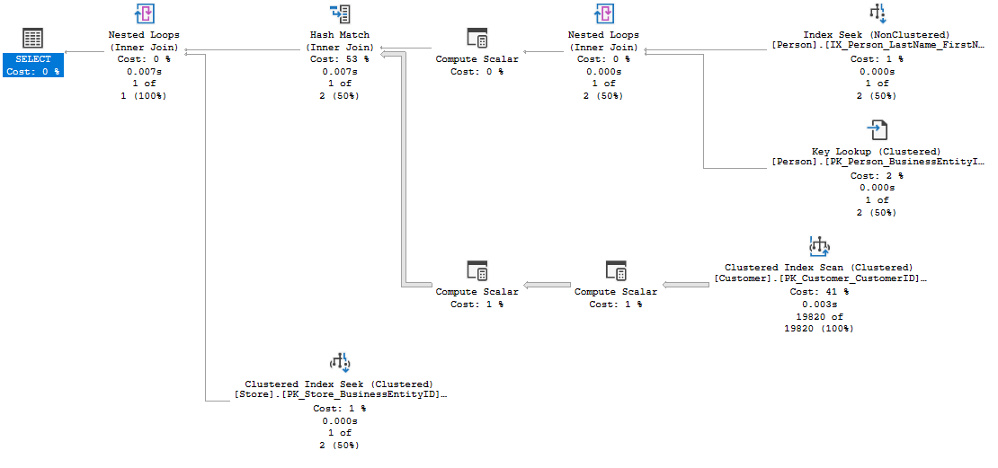

SSMS Graphical Plan
Execution Flow
5
3
1
3
Outer
Table
2
Inner table
4
6
Notes:
The basic guidelines for analyzing a query plan are:
Flow of data is read from right to left.
The width of the arrows gives an indication of the number of rows in each dataset, such as the one coming from the Customer table CL IX scan. This can often be a clue to high resource usage.
For joins:
The outer table appears on top.
Resultsets are created from each join pair, which is then passed to the next join.
Two crucial facts affect join performance:
The order in which more than two tables are joined.
The selection of outer/inner table.
Joins producing smaller result sets are performed first.
Local predicates are applied before the join.
Joins that reduce the number of rows are performed first.
Aggregation may be performed before the join.
This is all dependent on the accuracy of the statistics the Microsoft SQL Server Query processor has at compilation time.
Example Query:
SELECT p.Title + ' ' + p.FirstName + ' ' + p.LastName AS FullName, c.AccountNumber, s.Name
FROM Person.Person AS p
INNER JOIN Sales.Customer AS c ON c.PersonID = p.BusinessEntityID
INNER JOIN Sales.Store AS s ON s.BusinessEntityID = c.StoreID
WHERE p.LastName = 'Koski’
Resultset 1 and 2 are joined using a nested loops join, creating resultset 3.
Resultsets 3 and 4 are joined using a hash match join, creating resultset 5.
Resultsets 5 and 6 are joined using a nested loops join, creating a resultset for the Select clause.

Slide 24
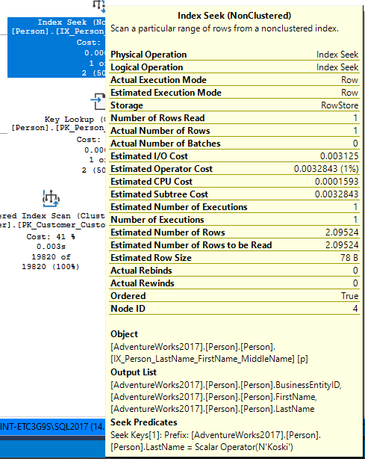
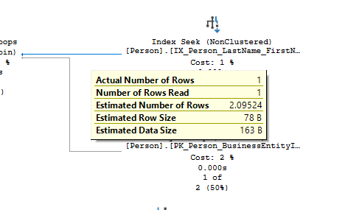
SSMS Graphical Plan
Data flow between the operators and statistical data of each operator
Statistical data for the operator
Data flow statistics
Notes:
Arrows represent the data flow between the iterators.
ToolTips provide detailed help, including a description of statistical data on each iterator; this includes estimates of the number of rows generated by each operator (that is, the cardinality estimates), the average row size, and the cost of the operator.

Slide 25
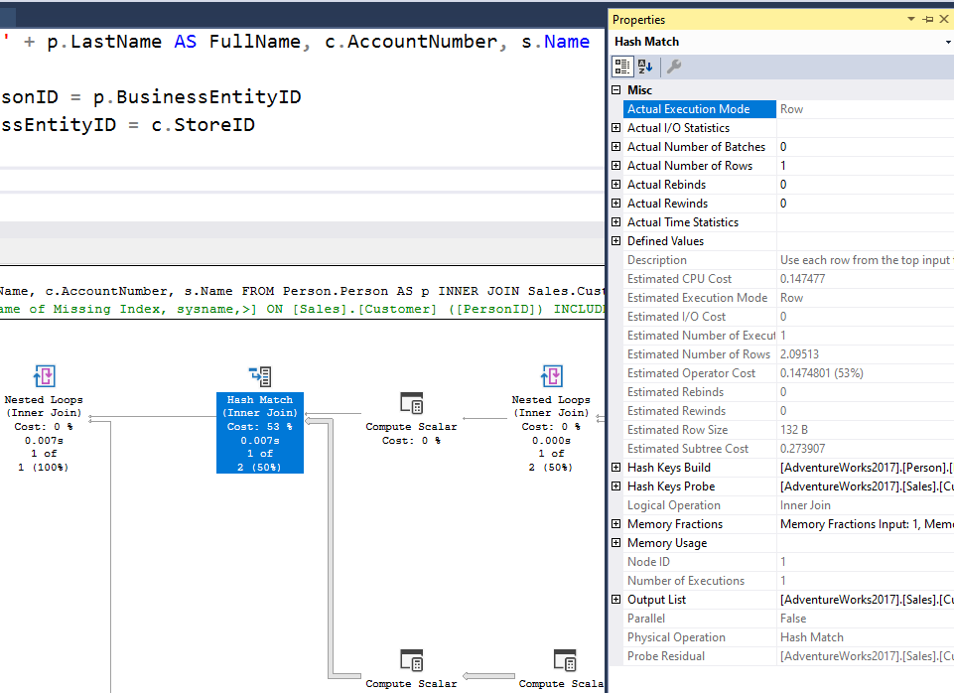
SSMS Graphical Plan
Properties sheet
Management Studio Properties sheet includes even more detailed information about each operator and about the overall query plan.
Use the most recent version of Management Studio as every new version display more detailed information about the Query Plan when examining the plan in graphical mode.
Notes:
The Management Studio Properties sheet includes even more detailed information about each operator and about the overall query plan.

Slide 26
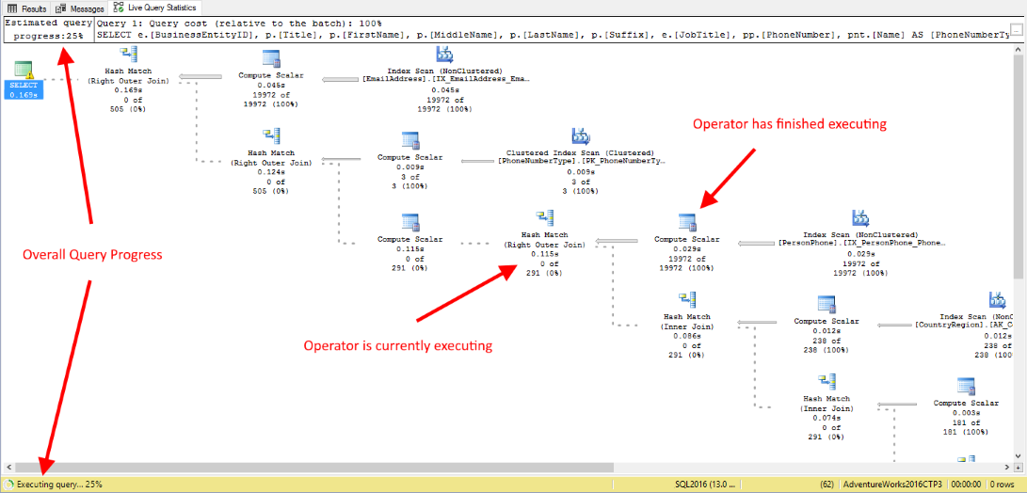
SSMS Graphical Plan
Live Query Statistics
View CPU/memory usage, execution time, and query progress
Allows drill down to live operator-level statistics, such as:
Number of generated rows
Elapsed time
Operator progress
Live warnings
This feature is primarily intended for troubleshooting purposes.
Using this feature can moderately slow the overall query performance.
Notes:
SQL Server Management Studio provides the ability to view the live execution plan of an active query. This live query plan provides real-time insights into the query execution process as the controls flow from one query plan operator to another. The live query plan displays the overall query progress and operator-level run-time execution statistics such as the number of rows produced, elapsed time, operator progress, and so on. Because this data is available in real time without needing to wait for the query to complete, these execution statistics are extremely useful for debugging query performance issues.
This feature is available beginning with SQL Server 2016 (13.x) Management Studio, however it can work with SQL Server 2014 (12.x).
Internally, live query statistics leverages the sys.dm_exec_query_profiles DMV.
To view live query statistics for one query, on the tools menu click the Include Live Query Statistics icon. The live execution plan can also be accessed from the Activity Monitor.
For further information refer to:
https://docs.microsoft.com/en-us/sql/relational-databases/performance/live-query-statistics

Slide 27












Execution Plan
Notable operators
Operators describe how SQL Server executes a query. The query optimizer uses operators to build a query plan to create the result specified in the query.
Table scan
Nonclustered index scan
Clustered index scan
Nonclustered index seek
Clustered index seek
Sort
RID lookup
Table spool
Key lookup
Index spool
ColumnStore Index Scan
Stream Aggregation
Notes:
Further Reading: Showplan Logical & Physical Operators Reference - SQL Server | Microsoft Learn
Operators describe how SQL Server executes a query or a Data Manipulation Language (DML) statement. The query optimizer uses operators to build a query plan to create the result specified in the query, or to perform the operation specified in the DML statement. The query plan is a tree consisting of physical operators. You can view the query plan by using the SET SHOWPLAN statements, the graphical execution plan options in SQL Server Management Studio, or the SQL Server Profiler Showplan event classes.
Operators are classified as logical and physical operators.
Logical Operators Logical operators describe the relational algebraic operation used to process a statement. In other words, logical operators describe conceptually what operation needs to be performed.
Physical Operators Physical operators implement the operation described by logical operators. Each physical operator is an object or routine that performs an operation. For example, some physical operators access columns or rows from a table, index or view. Other physical operators perform other operations such as calculations, aggregations, data integrity checks or joins. Physical operators have costs associated with them.
The Table Scan operator retrieves all rows from the table specified in the Argument column of the query execution plan. If a WHERE:() predicate appears in the Argument column, only those rows that satisfy the predicate are returned. Table Scan is a logical and physical operator. Normally used on Heap tables.
The Clustered Index Scan operator scans the clustered index specified in the Argument column of the query execution plan. When an optional WHERE:() predicate is present, only those rows that satisfy the predicate are returned. If the Argument column contains the ORDERED clause, the query processor has requested that the output of the rows be returned in the order in which the clustered index has sorted it. If the ORDERED clause is not present, the storage engine scans the index in the optimal way, without necessarily sorting the output. Clustered Index Scan is a logical and physical operator.
The Clustered Index Seek operator uses the seeking ability of indexes to retrieve rows from a clustered index. The Argument column contains the name of the clustered index being used and the SEEK:() predicate. The storage engine uses the index to process only those rows that satisfy this SEEK:() predicate. It can also include a WHERE:() predicate where the storage engine evaluates against all rows that satisfy the SEEK:() predicate, but this is optional and does not use indexes to complete this process.
RID Lookup is a bookmark lookup on a heap using a supplied row identifier (RID). The Argument column contains the bookmark label used to look up the row in the table and the name of the table in which the row is looked up. RID Lookup is always accompanied by a NESTED LOOP JOIN. RID Lookup is a physical operator.
The Key Lookup operator is a bookmark lookup on a table with a clustered index. The Argument column contains the name of the clustered index and the clustering key used to look up the row in the clustered index. Key Lookup is always accompanied by a Nested Loops operator. If the WITH PREFETCH clause appears in the Argument column, the query processor has determined that it is optimal to use asynchronous prefetching (read-ahead) when looking up bookmarks in the clustered index. The use of a Key Lookup operator in a query plan indicates that the query might benefit from performance tuning. For example, query performance might be improved by adding a covering index.
The Columnstore Index Scan operator scans the columnstore index specified in the Argument column of the query execution plan.
The Index Scan operator retrieves all rows from the nonclustered index specified in the Argument column. If an optional WHERE:() predicate appears in the Argument column, only those rows that satisfy the predicate are returned. Index Scan is a logical and physical operator.
The Index Seek operator uses the seeking ability of indexes to retrieve rows from a nonclustered index. The Argument column contains the name of the nonclustered index being used. It also contains the SEEK:() predicate. The storage engine uses the index to process only those rows that satisfy the SEEK:() predicate. It optionally may include a WHERE:() predicate, which the storage engine will evaluate against all rows that satisfy the SEEK:() predicate (it does not use the indexes to do this). If the Argument column contains the ORDERED clause, the query processor has determined that the rows must be returned in the order in which the nonclustered index has sorted them. If the ORDERED clause is not present, the storage engine searches the index in the optimal way (which does not guarantee that the output will be sorted). Allowing the output to retain its ordering may be less efficient than producing non-sorted output. Index Seek is a logical and physical operator.
The Sort operator sorts all incoming rows. The Argument column contains either a DISTINCT ORDER BY:() predicate if duplicates are removed by this operation, or an ORDER BY:() predicate with a comma-separated list of the columns being sorted. The columns are prefixed with the value ASC if the columns are sorted in ascending order, or the value DESC if the columns are sorted in descending order. Sort is a logical and physical operator.
The Table Spool operator scans the input and places a copy of each row in a hidden spool table that is stored in the tempdb database and existing only for the lifetime of the query. If the operator is rewound (for example, by a Nested Loops operator) but no rebinding is needed, the spooled data is used instead of rescanning the input. Table Spool is a physical operator.
The Index Spool physical operator contains a SEEK:() predicate in the Argument column. The Index Spool operator scans its input rows, placing a copy of each row in a hidden spool file (stored in the tempdb database and existing only for the lifetime of the query), and builds a nonclustered index on the rows. This allows you to use the seeking capability of indexes to output only those rows that satisfy the SEEK:() predicate. If the operator is rewound (for example, by a Nested Loops operator) but no rebinding is needed, the spooled data is used instead of rescanning the input.
The Stream Aggregate operator requires input ordered by the columns within its groups. The optimizer will use a Sort operator prior to this operator if the data is not already sorted due to a prior Sort operator or due to an ordered index seek or scan. In the SHOWPLAN_ALL statement or the graphical execution plan in SQL Server Management Studio, the columns in the GROUP BY predicate are listed in the Argument column, and the aggregate expressions are listed in the Defined Values column. Stream Aggregate is a physical operator.

Slide 28
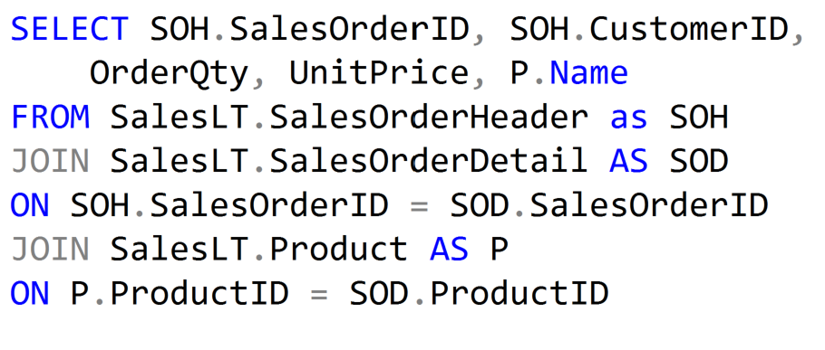
Execution Plan Join Operators (Code)

Slide 29



Execution Plan Join Operators
A Merge Join is useful if both table inputs are in the same sorted order on the same value.
A Hash Match is used when the tables being joined are not in the same sorted order.
A Nested Loop is use when a small (outer) table is used to lookup a value in a larger (inner) table.
Notes:
Further Reading: Joins (SQL Server) - SQL Server | Microsoft Learn
Merge Joins
If the two join inputs are not small but are sorted on their join column (for example, if they were obtained by scanning sorted indexes), a merge join is the fastest join operation. If both join inputs are large and the two inputs are of similar sizes, a merge join with prior sorting and a hash join offer similar performance. However, hash join operations are often much faster if the two input sizes differ significantly from each other.
The merge join requires both inputs to be sorted on the merge columns, which are defined by the equality (ON) clauses of the join predicate. The query optimizer typically scans an index, if one exists on the proper set of columns, or it places a sort operator below the merge join. In rare cases, there may be multiple equality clauses, but the merge columns are taken from only some of the available equality clauses.
Because each input is sorted, the Merge Join operator gets a row from each input and compares them. For example, for inner join operations, the rows are returned if they are equal. If they are not equal, the lower-value row is discarded and another row is obtained from that input. This process repeats until all rows have been processed.
The merge join operation may be either a regular or a many-to-many operation. A many-to-many merge join uses a temporary table to store rows. If there are duplicate values from each input, one of the inputs has to rewind to the start of the duplicates as each duplicate from the other input is processed.
If a residual predicate is present, all rows that satisfy the merge predicate evaluate the residual predicate, and only those rows that satisfy it are returned.
Merge join itself is very fast, but it can be an expensive choice if sort operations are required. However, if the data volume is large and the desired data can be obtained presorted from existing B-tree indexes, merge join is often the fastest available join algorithm.
Hash Match Joins
Hash joins can efficiently process large, unsorted, nonindexed inputs. They are useful for intermediate results in complex queries because:
Intermediate results are not indexed (unless explicitly saved to disk and then indexed) and often are not suitably sorted for the next operation in the query plan.
Query optimizers estimate only intermediate result sizes. Because estimates can be very inaccurate for complex queries, algorithms to process intermediate results not only must be efficient, but also must degrade gracefully if an intermediate result turns out to be much larger than anticipated.
The hash join allows reductions in the use of denormalization. Denormalization is typically used to achieve better performance by reducing join operations, in spite of the dangers of redundancy, such as inconsistent updates. Hash joins reduce the need to denormalize. Hash joins allow vertical partitioning (representing groups of columns from a single table in separate files or indexes) to become a viable option for physical database design.
The hash join has two inputs: the build input and probe input. The query optimizer assigns these roles so that the smaller of the two inputs is the build input.
Hash joins are used for many types of set-matching operations: inner join; left, right, and full outer join; left and right semi-join; intersection; union; and difference. Moreover, a variant of the hash join can do duplicate removal and grouping, such as SUM(salary) GROUP BY department. These modifications use only one input for both the build and probe roles.
Nested Loops Joins
If one join input is small (fewer than 10 rows) and the other join input is fairly large and indexed on its join columns, an index nested loops join is the fastest join operation because they require the least I/O and the fewest comparisons.
The nested loops join, also called nested iteration, uses one join input as the outer input table (shown as the top input in the graphical execution plan) and one as the inner (bottom) input table. The outer loop consumes the outer input table row by row. The inner loop, executed for each outer row, searches for matching rows in the inner input table.
In the simplest case, the search scans an entire table or index; this is called a naive nested loops join. If the search exploits an index, it is called an index nested loops join. If the index is built as part of the query plan (and destroyed upon completion of the query), it is called a temporary index nested loops join. All these variants are considered by the Query Optimizer.
A nested loops join is particularly effective if the outer input is small and the inner input is preindexed and large. In many small transactions, such as those affecting only a small set of rows, index nested loops joins are superior to both merge joins and hash joins. In large queries, however, nested loops joins are often not the optimal choice.
When the OPTIMIZED attribute of a Nested Loops join operator is set to True, it means that an Optimized Nested Loops (or Batch Sort) is used to minimize I/O when the inner side table is large, regardless of it being parallelized or not. The presence of this optimization in a given plan may not be very obvious when analyzing an execution plan, given the sort itself is a hidden operation. But by looking in the plan XML for the attribute OPTIMIZED, this indicates the Nested Loops join may try to reorder the input rows to improve I/O performance.

Slide 30
Query Hint Types
Query Hints
Applied to the whole query using the OPTION clause
Table Hints
Applied to single tables in the query
Join Hints
Applied to specific joins only
Use Hints
Examples: MAXDOP, RECOMPILE, OPTIMIZE FOR
Examples: FORCESEEK, FORCESCAN, and INDEX
Examples: LOOP, MERGE, and HASH
Provides one or more additional hints to the query processor.
Example: ENABLE_QUERY_OPTIMIZER_HOTFIXES
Notes:
Hints are options or strategies specified for enforcement by the SQL Server query processor on SELECT, INSERT, UPDATE, or DELETE statements. The hints override any execution plan the query optimizer might select for a query.
Caution
Because the SQL Server Query Optimizer typically selects the best execution plan for a query, we recommend only using hints as a last resort for experienced developers and database administrators.
For detailed information of each query hint refer to: Query Hints (Transact-SQL) - SQL Server | Microsoft Learn
Query hints specify that the indicated hints should be used throughout the query. They affect all operators in the statement. If UNION is involved in the main query, only the last query involving a UNION operation can have the OPTION clause. Query hints are specified as part of the OPTION clause. Error 8622 occurs if one or more query hints cause the Query Optimizer not to generate a valid plan.
Applies to:
DELETE, INSERT, SELECT, UPDATE and MERGE
For detailed information of each table hint refer to: Hints (Transact-SQL) - SQL Server | Microsoft Learn
Table hints override the default behavior of the query optimizer for the duration of the data manipulation language (DML) statement by specifying a locking method, one or more indexes, a query-processing operation such as a table scan or index seek, or other options. Table hints are specified in the FROM clause of the DML statement and affect only the table or view referenced in that clause.
Applies to:
DELETE, INSERT, SELECT, UPDATE and MERGE
For detailed information of each named use hint refer to: Join Hints (Transact-SQL) - SQL Server | Microsoft Learn
Applies to:
DELETE, SELECT and UPDATE
For detailed information of each named use hint refer to: Query Hints (Transact-SQL) - SQL Server | Microsoft Learn
There’s also a new DMV sys.dm_exec_valid_use_hints that lists supported name hints. This is not meant a dictionary, but rather as a tool that will allow a developer to determine if a specific hint is available in a given version, where code is intended to execute, before it actually does.
USE HINT ( 'hint_name' )
Applies to: SQL Server (starting with SQL Server 2016 (13.x) SP1) and Azure SQL Database.
Provides one or more additional hints to the query processor. The additional hints are specified by a hint name inside single quotation marks.
Applies to:
DELETE, INSERT, SELECT, UPDATE and MERGE

Slide 31
What to look for in the query plan
Left Most Operator
Expensive Operators
Nested Loop Operator
Scans vs Seeks
Skewed Estimates
Warnings
Data Flow Statistics
Information about possible issues with the plan
Overall properties of the plan to establish baseline
Look from most expensive to least expensive
Thicker arrows mean more data is being passed
Possible to create index that covers query
Not necessarily bad, but could indicate I/O issues
Statistics could be stale or invalid
Sort Operators
Locate why there is a sort operation and is it needed
Right to Left
Solve issues early in the plan

Slide 32

Demonstration
Query Plan Analysis
Use the graphical execution plan and IO statistics to tune a query.
Explore Live Query Statistics.
Notes:
M07L03Demo01
Go to the Lab VM
Go through e:\Demos\M07L03Demo01\AnalyzingPlanOperators.sql
Go through e:\Demos\M07L03Demo01\LiveQueryStatistics.sql

Slide 33

Query Plan Analysis
Identifying and tuning high cost operators in the query plan
Notes:
M07L03Lab01

Slide 34
Questions?

Slide 35
Knowledge Check
What are the physical join operators?
What is a method to eliminate a lookup?
Is it recommended to eliminate all lookups operators?
Under what circumstances would a table scan be more efficient than an index seek on a non-clustered, non-covering index?
Is a Clustered Index Scan more efficient than a Table Scan?
Notes:
Q1: What are the physical join operators?
A1: The three physical join operators are hash, merge, and loop.
Q2: What is a method to eliminate a lookup?
A2: A lookup can be eliminated with a nonclustered covering index.
Q3:Is it recommended to eliminate all lookups operators?
A3: No, removing all lookup operators could cause that you create big non clustered indexes that can cause index maintenance to be non practical. You must remove lookup operators only when the performance gain will be really significant.
Q4: Under what circumstances would a table scan be more efficient than an index seek on a non-clustered, non-covering index?
A4: If the number of logical reads in a table scan is less than the number of logical reads for a seek and lookup for each row required by an operation.
Q5: Is a Clustered Index Scan more efficient than a Table Scan?
A5: No, even when the plan “uses” an index, the Clustered Index is just the table ordered so it is as bad as a table scan. Consider that the Clustered Index is bigger than the HEAP so scanning the clustered index can cause more IO than scanning the HEAP.

